Slide 1
Entering the List of Participants for the IHSA Tennis Sectionals
Tennis State Series – Two Part Entry Process
Part 1 - IHSA Schools Center -
https://www.ihsa.org/default.aspx
Pat 2 - Tennis Reporting - https://tennisreporting.com/

Slide 2

Part 1
Step 1 - Go to IHSA.org – Click on Schools Center and log in with your IHSA login & password (passwords can be secured from your athletic director)

Slide 3
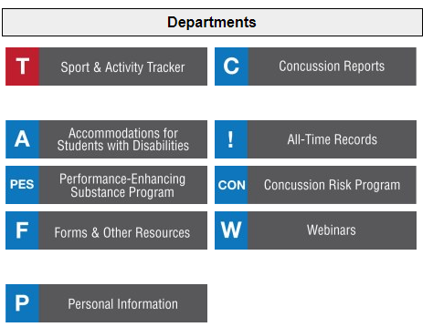
Step 2 - Click on T for Sports & Activity Tracker

Slide 4
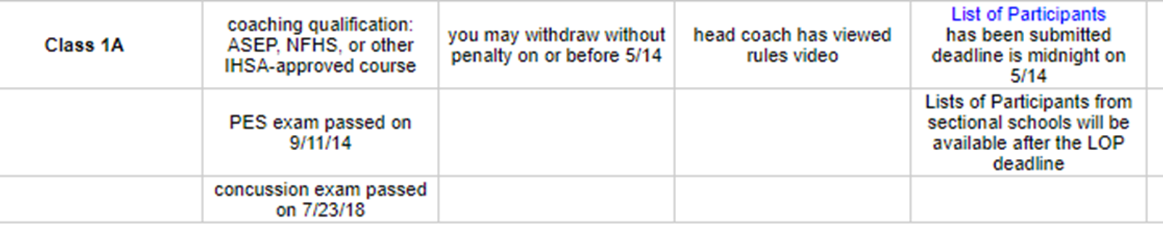
Step 3 - Click on List of Participants

Slide 5
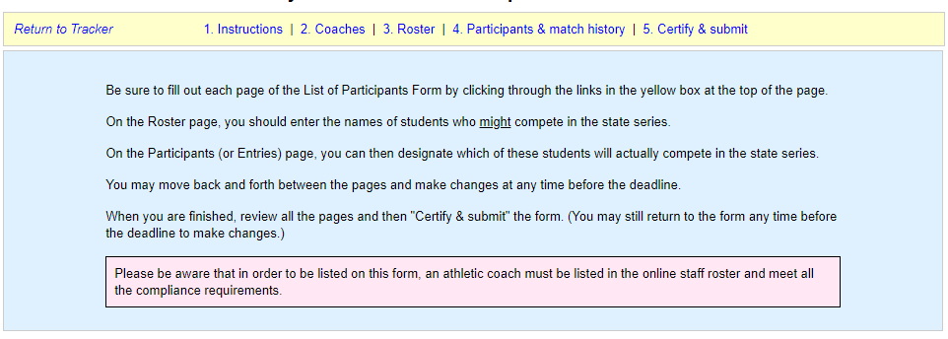
Step 4 - Read Instructions

Slide 6
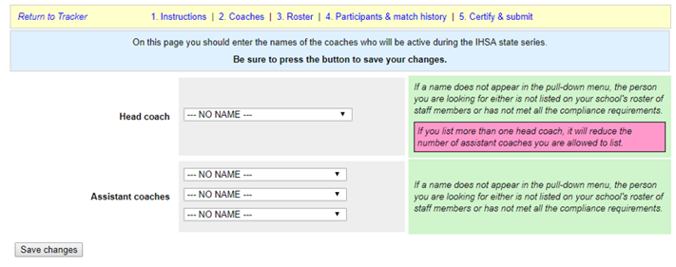
Step 5 - Click on Coaches and enter the Head Coach and all Assistant Coaches
Use the drop-down menu to select the coaches name(s) that your school’s athletic director has confirmed compliant with IHSA Coaching Qualifications By-laws & State Mandated Concussion Exam & PES Exam. List every coach that you anticipate coaching at the state final, so we can accurately issue coaching passes. If a coach’s name is not on this list, they will not receive credentials to coach at the state final. If a coach's name does not appear on the drop-down list, they may need to complete steps to be in compliance with the IHSA coaching bylaw 2.070. Contact your athletic director to confirm compliance.

Slide 7
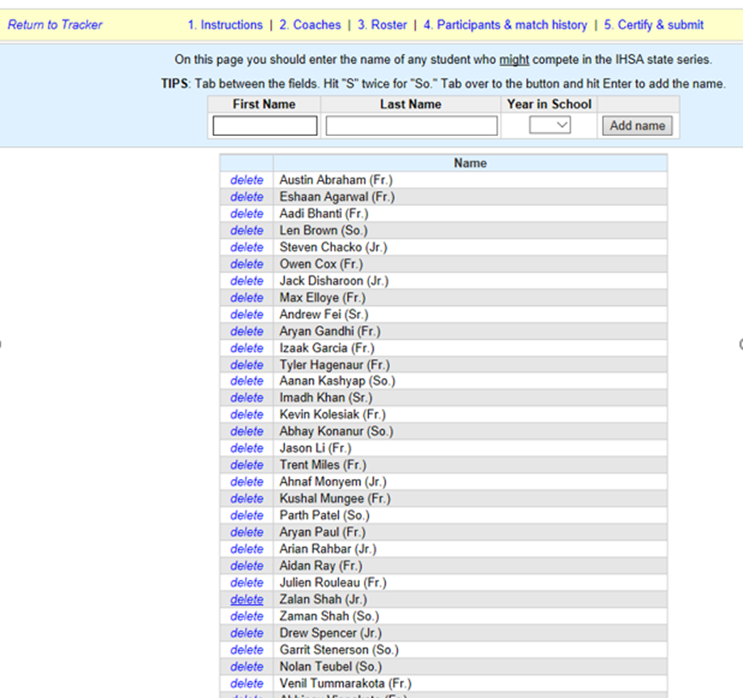
Step 6 - List your Current Roster
Include more than the allowable number of players (two doubles and two singles players – 6 players) in case you need to make line up changes due to academic eligibility or disciplinary issues. We recommend rostering your entire team. If a student’s name does not appear on the roster, you cannot make lineup changes.

Slide 8
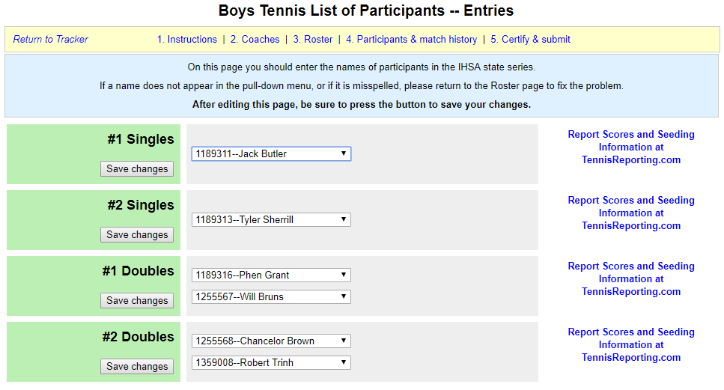
Step 7 - Click on Participants & Match History
Use the drop-down menu to enter the players from your roster into the lineup. Click Save Changes after every entry.

Slide 9
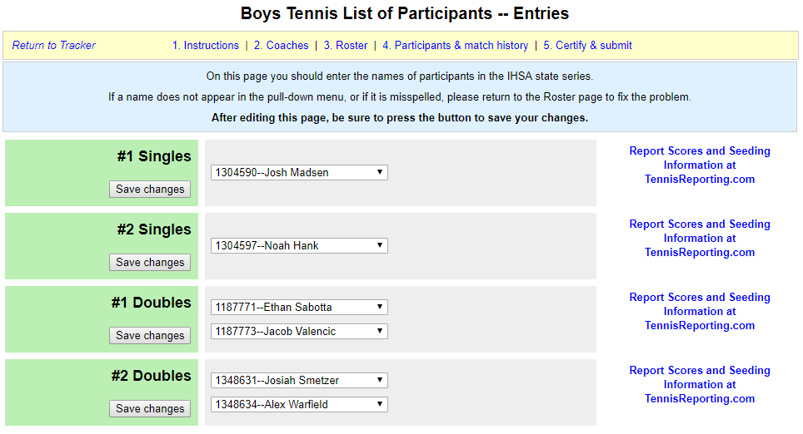
Step 8 – Click on Report Scores and Seeding Information at TennisReporting.com
Once you click on the link you will be taken to the Tennis Reporting page.
You should have been invited to an IHSA sectional by tennisreporting.com. This is where you transition to Part 2.

Slide 10

Part 2
Step 9 – Log in to your Tennis Reporting Account
You created your own password and log in.
This is the account you should be using all season to enter your online scorebook/players matches.

Slide 11

Step 10 – Click on your invited Event – IHSA
Once Logged into your Tennis Reporting Account, you will see that you have been invited to an Event – IHSA Sectional.
Once you click on Events, you will be taken to a drop-down menu where you can add your line up which also automatically links their Player Season Reports (PSRs).
This information is used for the Sectional and State Seed Meetings.

Slide 12
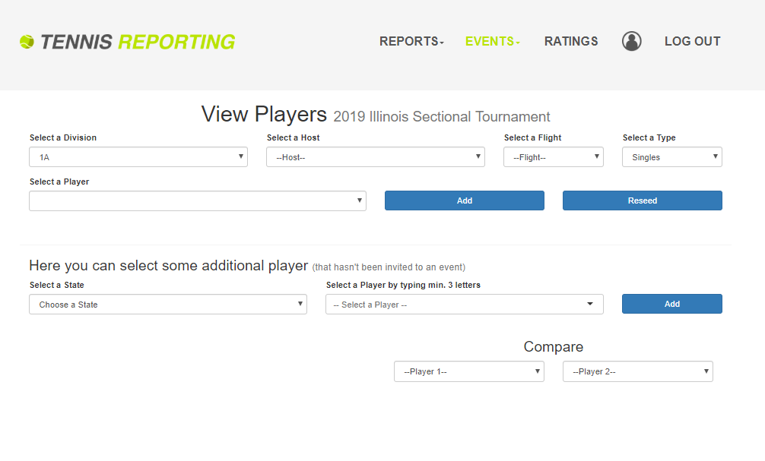
Make the Appropriate Selections for Your Sectional
Click on Division for 1A or 2A Sectionals
Select your Sectional Host Site
Select if the player is 1 or 2 (Flight) Your #1 singles or doubles should go in the 1 flight, etc…
Select Singles or Doubles

Slide 13
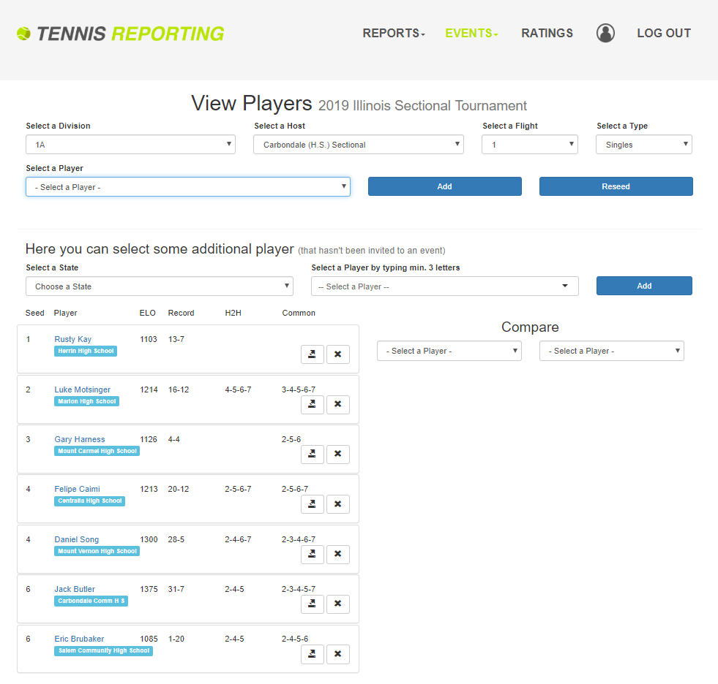
Select Players into the Sectional Line Up
Use the drop-down arrow to Select a Player to add to the
1 or 2 Singles Flight
Or
1 or 2 Doubles Flight

Slide 14
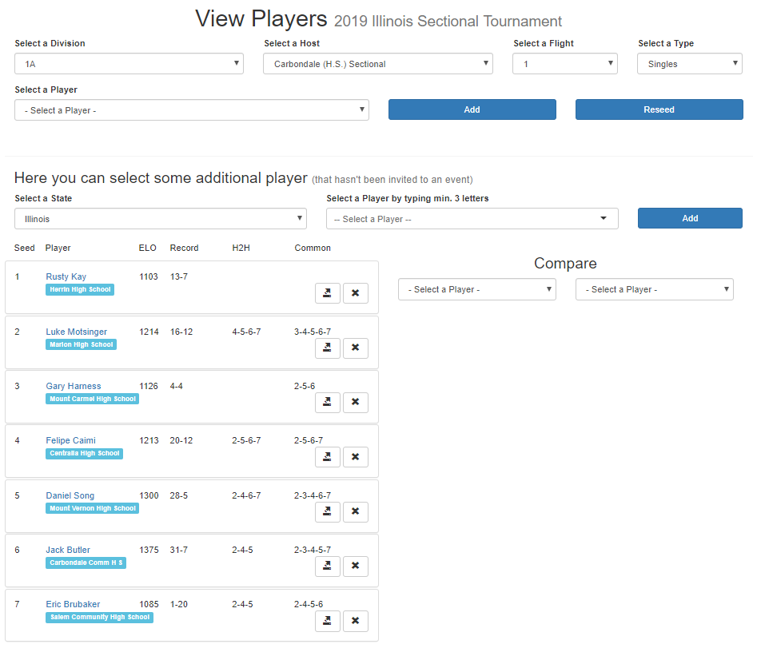
Line-Ups
Once line-ups are set by Midnight on Tuesday prior to the sectional seed meeting – The ability to change your line-up will not be allowed. Contact the IHSA office if you have an injury or ineligibility issue.
Other coaches/sectionals will not be able to see line-ups until the Event is open after 10 a.m. on Wednesday prior to sectionals for Sectionals to prepare for their Seed Meetings.
The arrow to the right of a player's name will show their PSR – The X to the right of a player's name will delete the player from the Sectional Line-Up

Slide 15
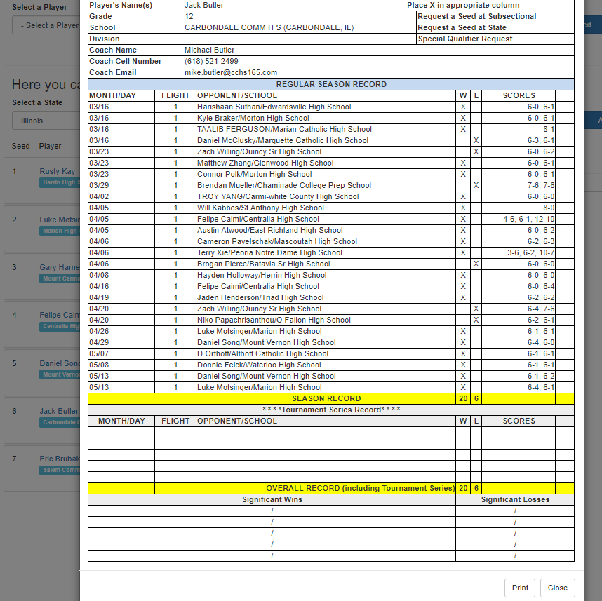
Features
Once the line ups are set, you can use features to look at the players PSRs .

Slide 16
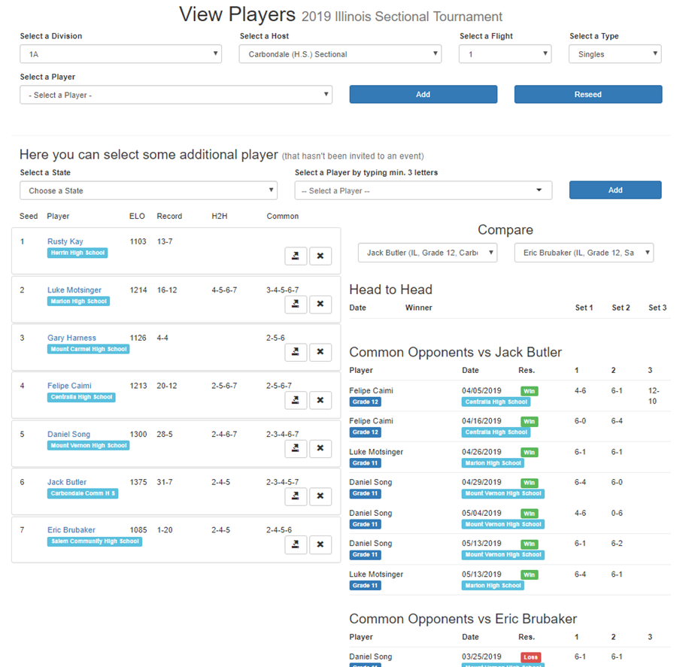
Features
You can navigate through the page to Seed the Players by clicking on their names and moving them to the appropriate seeded number spot.
You can place two players in the compare section to look at Head-to-Head wins.
Note: The IHSA does not utilize the ELO feature – just ignore that number for now

Slide 17
Questions:
IHSA - If you have any questions, please contact ccarr@ihsa.org or call the IHSA at 309-663-6377.
Tennis Reporting - If you have any questions, please contact TennisReporting@gmail.com or call Steve at 651-261-7283.
Tennis State Series
Thank You!

