Slide 1

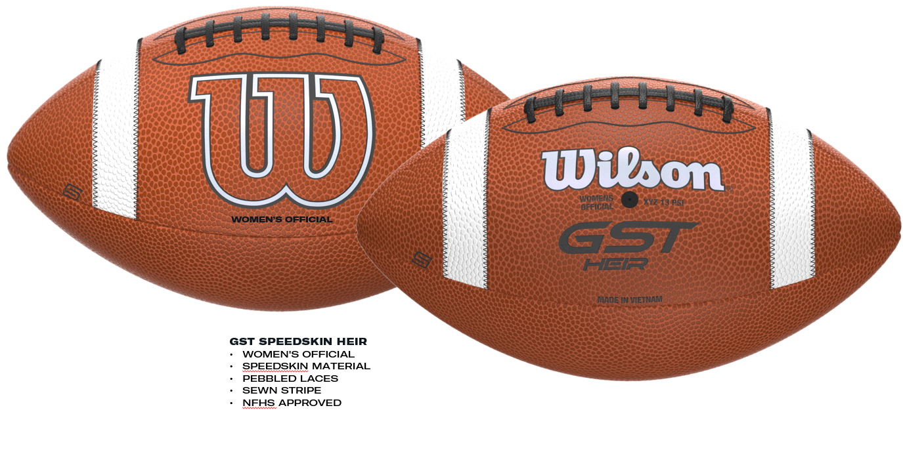
GST SPEEDSKIN HEIR ($45)

